Slide 1
CSE 331
Event-driven Programming and
Graphical User Interfaces (GUIs) with Swing/AWT
slides created by Marty Stepp
based on materials by M. Ernst, S. Reges, D. Notkin, R. Mercer, Wikipedia
http://www.cs.washington.edu/331/

Slide 2
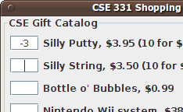
Why learn GUIs?
Learn about event-driven programming techniques
Practice learning and using a large, complex API
A chance to see how it is designed and learn from it:
  model-view separation
  design patterns
  refactoring vs. reimplementing an ailing API
Because GUIs are neat!
Caution: There is way more here than you can memorize.
  Part of learning a large API is "letting go."
  You won't memorize it all; you will look things up as you need them.
  But you can learn the fundamental concepts and general ideas.

Slide 3

Java GUI History
Abstract Windowing Toolkit (AWT): Sun's initial effort to create a set of cross-platform GUI classes. (JDK 1.0 - 1.1)
  Maps general Java code to each operating system's real GUI system.
  Problems: Limited to lowest common denominator; clunky to use.
Swing: A newer GUI library written from the ground up that allows much more powerful graphics and GUI construction. (JDK 1.2+)
  Paints GUI controls itself pixel-by-pixel rather than handing off to OS.
  Benefits: Features; compatibility; OO design.
  Problem: Both exist in Java now; easy to get them
  mixed up; still have to use both in various places.

Slide 4

GUI terminology
window: A first-class citizen of the graphical desktop.
  Also called a top-level container.
  examples: frame, dialog box, applet
component: A GUI widget that resides in a window.
  Also called controls in many other languages.
  examples: button, text box, label
container: A logical grouping for storing components.
  examples: panel, box

Slide 5
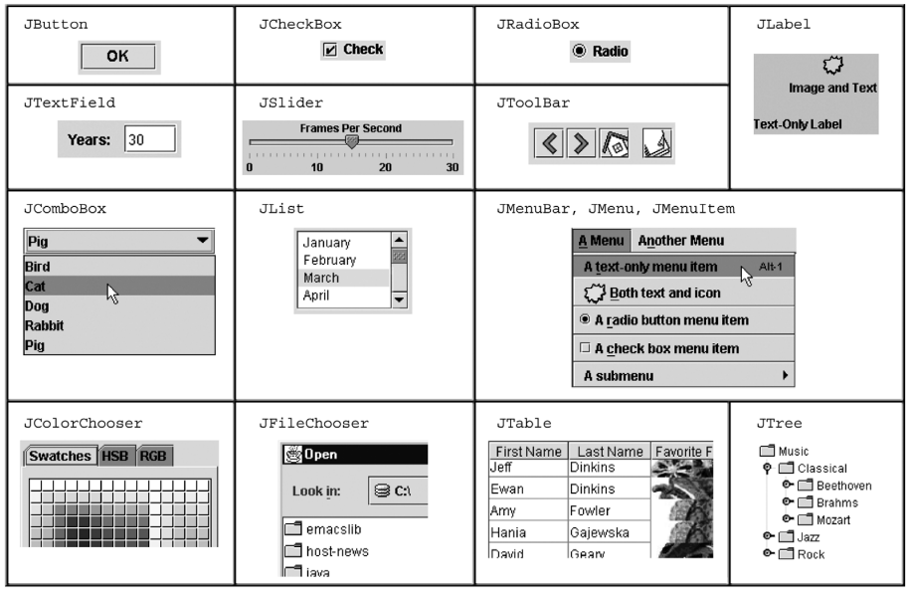
Components

Slide 6
Swing inheritance hierarchy
Component (AWT)
  Window
    Frame
      JFrame (Swing)
      JDialog
  Container
    JComponent (Swing)
      JButton JColorChooser JFileChooser
      JComboBox JLabel JList
      JMenuBar JOptionPane JPanel
      JPopupMenu JProgressBar JScrollbar
      JScrollPane JSlider JSpinner
      JSplitPane JTabbedPane JTable
      JToolbar JTree JTextArea
      JTextField ...
import java.awt.*;
import javax.swing.*;

Slide 7
Component properties
  Each has a get (or is) accessor and a set modifier method.
  examples: getColor, setFont, setEnabled, isVisible
name | type | description
background | Color | background color behind component
border | Border | border line around component
enabled | boolean | whether it can be interacted with
focusable | boolean | whether key text can be typed on it
font | Font | font used for text in component
foreground | Color | foreground color of component
height, width | int | component's current size in pixels
visible | boolean | whether component can be seen
tooltip text | String | text shown when hovering mouse
size, minimum / maximum / preferred size | Dimension | various sizes, size limits, or desired sizes that the component may take

Slide 8
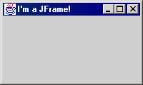
JFrame
a graphical window to hold other components
public JFrame()
public JFrame(String title)
Creates a frame with an optional title.
  Call setVisible(true) to make a frame appear on the screen after creating it.
public void add(Component comp)
Places the given component or container inside the frame.

Slide 9
More JFrame
public void setDefaultCloseOperation(int op)
Makes the frame perform the given action when it closes.
  Common value passed: JFrame.EXIT_ON_CLOSE
  If not set, the program will never exit even if the frame is closed.
public void setSize(int width, int height)
Gives the frame a fixed size in pixels.
public void pack()
Resizes the frame to fit the components inside it snugly.

Slide 10
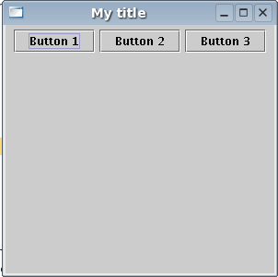
JButton
a clickable region for causing actions to occur
public JButton(String text)
Creates a new button with the given string as its text.
public String getText()
Returns the text showing on the button.
public void setText(String text)
Sets button's text to be the given string.

Slide 11
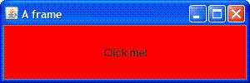
GUI example
import java.awt.*; // Where is the other button?
import javax.swing.*;
public class GuiExample1 {
public static void main(String[] args) {
JFrame frame = new JFrame();
frame.setDefaultCloseOperation(JFrame.EXIT_ON_CLOSE);
frame.setSize(new Dimension(300, 100));
frame.setTitle("A frame");
JButton button1 = new JButton();
button1.setText("I'm a button.");
button1.setBackground(Color.BLUE);
frame.add(button1);
JButton button2 = new JButton();
button2.setText("Click me!");
button2.setBackground(Color.RED);
frame.add(button2);
frame.setVisible(true);
}
}

Slide 12
Sizing and positioning
How does the programmer specify where each component appears, how big each component should be, and what the component should do if the window is resized / moved / maximized / etc.?
Absolute positioning (C++, C#, others):
Programmer specifies exact pixel coordinates of every component.
  "Put this button at (x=15, y=75) and make it 70x31 px in size."
Layout managers (Java):
Objects that decide where to position each component based on some general rules or criteria.
  "Put these four buttons into a 2x2 grid and put these text boxes in a horizontal flow in the south part of the frame."

Slide 13
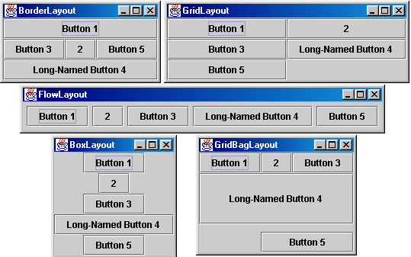
Containers and layout
Place components in a container; add the container to a frame.
  container: An object that stores components and governs their positions, sizes, and resizing behavior.

Slide 14
JFrame as container
A JFrame is a container. Containers have these methods:
public void add(Component comp)
public void add(Component comp, Object info)
Adds a component to the container, possibly giving extra information about where to place it.
public void remove(Component comp)
public void setLayout(LayoutManager mgr)
Uses the given layout manager to position components.
public void validate()
Refreshes the layout (if it changes after the container is onscreen).

Slide 15

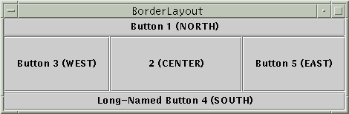
Preferred sizes
Swing component objects each have a certain size they would "like" to be: Just large enough to fit their contents (text, icons, etc.).
  This is called the preferred size of the component.
  Some types of layout managers (e.g. FlowLayout) choose to size the components inside them to the preferred size.
  Others (e.g. BorderLayout, GridLayout) disregard the preferred size and use some other scheme to size the components.
Buttons at preferred size: Not preferred size:

Slide 16
FlowLayout
public FlowLayout()
treats container as a left-to-right, top-to-bottom "paragraph".
  Components are given preferred size, horizontally and vertically.
  Components are positioned in the order added.
  If too long, components wrap around to the next line.
myFrame.setLayout(new FlowLayout());
myFrame.add(new JButton("Button 1"));
  The default layout for containers other than JFrame (seen later).

Slide 17
BorderLayout
public BorderLayout()
Divides container into five regions:
  NORTH and SOUTH regions expand to fill region horizontally,
  and use the component's preferred size vertically.
  WEST and EAST regions expand to fill region vertically,
  and use the component's preferred size horizontally.
  CENTER uses all space not occupied by others.
  myFrame.setLayout(new BorderLayout());
  myFrame.add(new JButton("Button 1"), BorderLayout.NORTH);
  This is the default layout for a JFrame.

Slide 18
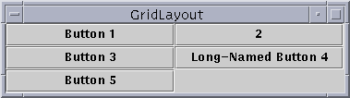
GridLayout
public GridLayout(int rows, int columns)
Treats container as a grid of equally-sized rows and columns.
Components are given equal horizontal / vertical size, disregarding preferred size.
Can specify 0 rows or columns to indicate expansion in that direction as needed.

Slide 19
Event Listeners

Slide 20
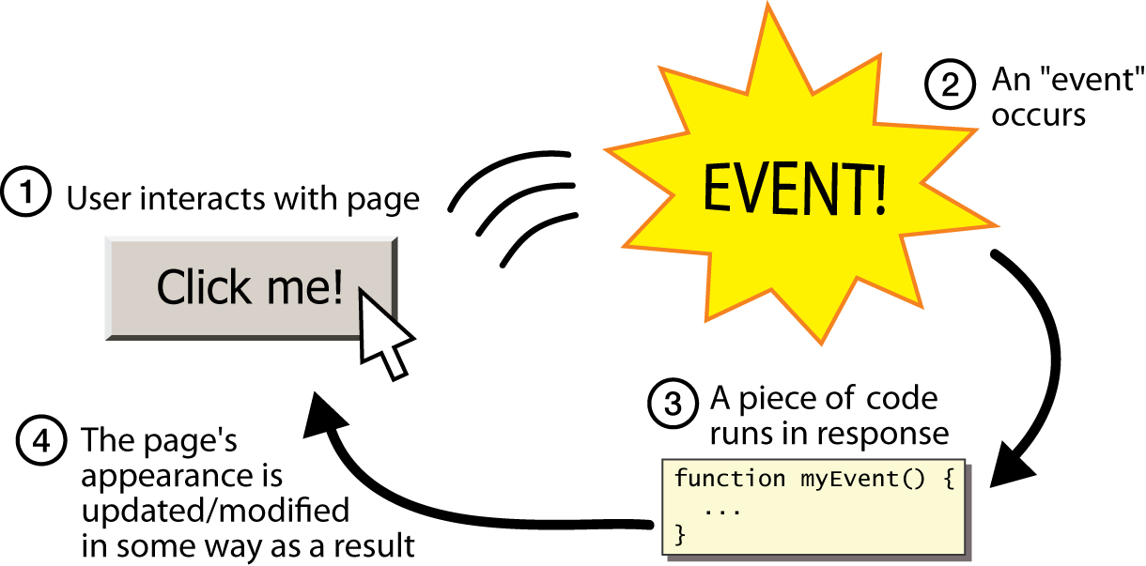
Graphical events
event: An object that represents a user's interaction with a GUI component; can be "handled" to create interactive components.
listener: An object that waits for events and responds to them.
  To handle an event, attach a listener to a component.
  The listener will be notified when the event occurs (e.g. button click).

Slide 21
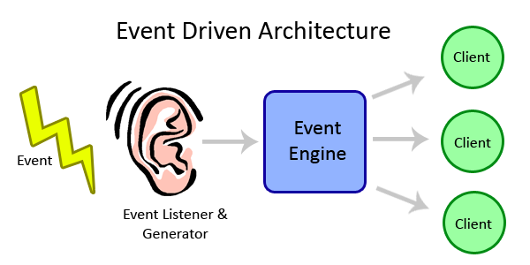
Event-driven programming
event-driven programming: A style of coding where a program's overall flow of execution is dictated by events.
  Rather than a central "main" method that drives execution,
  the program loads and waits for user input events.
  As each event occurs, the program runs particular code to respond.
  The overall flow of what code is executed is determined by the series of events that occur, not a pre-determined order.

Slide 22
Event hierarchy
EventObject
  AWTEvent (AWT)
    ActionEvent
    TextEvent
    ComponentEvent
      FocusEvent
      WindowEvent
      InputEvent
        KeyEvent
        MouseEvent
EventListener
  AWTEventListener
  ActionListener
  TextListener
  ComponentListener
  FocusListener
  WindowListener
  KeyListener
  MouseListener
import java.awt.event.*;

Slide 23

Action events
action event: An action that has occurred on a GUI component.
  The most common, general event type in Swing. Caused by:
    button or menu clicks,
    check box checking / unchecking,
    pressing Enter in a text field, ...
  Represented by a class named ActionEvent
  Handled by objects that implement interface ActionListener

Slide 24
Implementing a listener
public class name implements ActionListener {
public void actionPerformed(ActionEvent event) {
code to handle the event;
}
}
JButton and other graphical components have this method:
  public void addActionListener(ActionListener al)
  Attaches the given listener to be notified of clicks and events that occur on this component.

Slide 25

Nested classes
nested class: A class defined inside of another class.
Usefulness:
  Nested classes are hidden from other classes (encapsulated).
  Nested objects can access/modify the fields of their outer object.
Event listeners are often defined as nested classes inside a GUI.

Slide 26
Nested class syntax
// enclosing outer class
public class name {
...
// nested inner class
private class name {
...
}
}
  Only the outer class can see the nested class or make objects of it.
  Each nested object is associated with the outer object that created it, so it can access/modify that outer object's methods/fields.
    If necessary, can refer to outer object as OuterClassName.this

Slide 27
Static inner classes
// enclosing outer class
public class name {
...
// non-nested static inner class
public static class name {
...
}
}
  Static inner classes are not associated with a particular outer object.
  They cannot see the fields of the enclosing class.
  Usefulness: Clients can refer to and instantiate static inner classes:
    Outer.Inner name = new Outer.Inner(params);

Slide 28
GUI event example
public class MyGUI {
private JFrame frame;
private JButton stutter;
private JTextField textfield;
public MyGUI() {
...
stutter.addActionListener(new StutterListener());
}
...
// When button is clicked, doubles the field's text.
private class StutterListener implements ActionListener {
public void actionPerformed(ActionEvent event) {
String text = textfield.getText();
textfield.setText(text + text);
}
}
}

